Slide 1
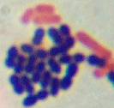
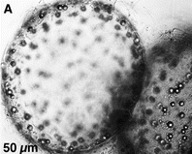
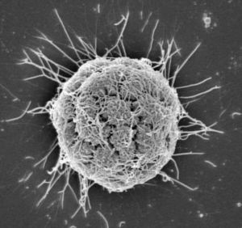
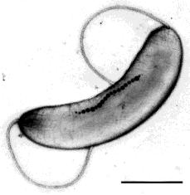
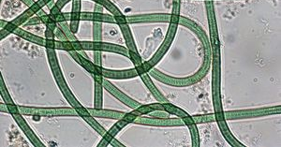
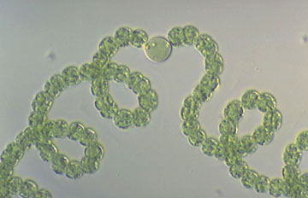
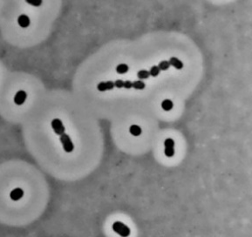
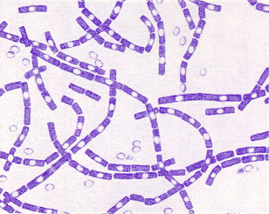
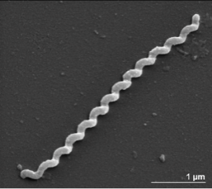
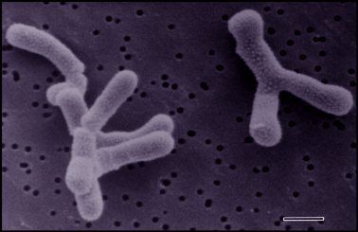
BM211 Introduction to Microbiology Workshop 1 – Microbial Ecology
Dr. Leighton Pritchard
leighton.pritchard@strath.ac.uk
@widdowquinn
Dr. Morgan Feeney morgan.feeney@strath.ac.uk @mostlymicrobia

Slide 2
Workshop 1 Learning Outcomes
By the end of this workshop, you should understand:
That microbes are diverse and play important roles in the environment
The use of Winogradsky columns to study microbial ecology
(something about alpha and beta diversity, hopefully)
And you should be able to:
Open and examine .csv files in R Studio
Use ggplot2 to make different types of plots

Slide 4
Life on this planet is mostly microbial
Microbes are diverse, able to grow/thrive/reproduce in diverse environments
Hug, L. A., Baker, B. J., Anantharaman, K., Brown, C. T., Probst, A. J., Castelle, C. J., et al. (2016). A new view of the tree of life. Nature Microbiology, 1–6. http://doi.org/10.1038/nmicrobiol.2016.48

Slide 5
Microbial Ecology
Background blahblahblah

Slide 6
A few notes about R Studio

Slide 7
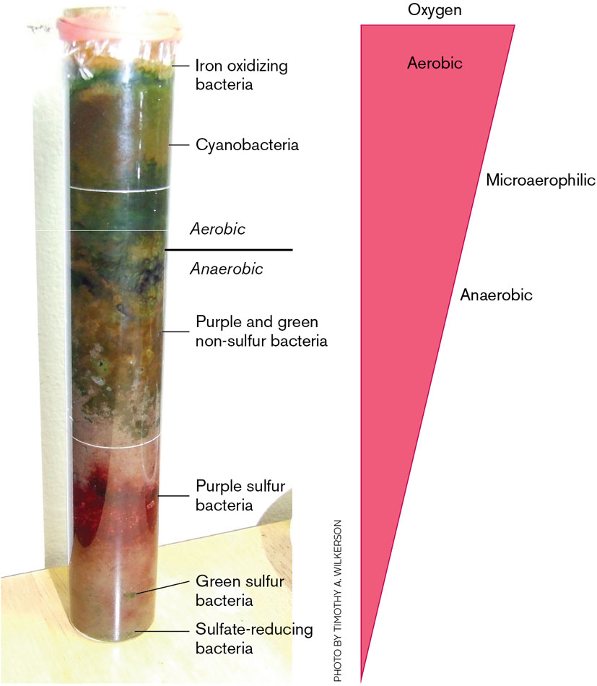
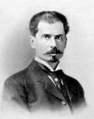
Sergei Winogradsky
Case study 1: Winogradsky columns
artificial microbial ecosystems
enrichment cultures (for different microbes depending on the substrate(s) added)
gradients of oxygen and other nutrients form; microbes grow in different zones according to their physiology
Pioneering molecular microbiologist and microbial ecologist
Biogeochemical cycles (N,S)
Chemosynthesis
Image credit: https://en.wikipedia.org/wiki/Sergei_Winogradsky

Slide 8
Winogradsky column experimental design details

Slide 9
Winogradsky column data → R Studio demo

Slide 10
Winogradsky column data → R Studio demo
Which of the plots is "best"/most effective/most useful?
How would you interpret these data? Which column do you think has the most cyanobacteria?
Are there any flaws in the experimental design?
Can you think of other ways to visualise and/or present these data?
Does the audience you are presenting the data to matter?
How would you present these data for publication in a scientific journal?

Slide 11
Case study 2:

Slide 12
Case study 3:

Slide 13
Additional exercises and resources

